Slide 1




Introduction to Supporting
Mental Health and Mental Wellbeing of Adults with Intellectual Disabilities
A training pack
Ruwani Ampegama, Karina Marshall-Tate,
Eddie Chaplin & Steve Hardy

Slide 2
Group agreement
Slide 2
Confidentiality - anonymise - for learning only.
Time keeping - breaks and activities.
Willing to contribute and share.
Respectful and non-judgemental.
Supportive to each other and individual needs.
Discussions not arguments.
Focus on points and not person.
Not a forum for making allegations or complaints.

Slide 3

Slide 3
Icebreaker
What do you see in the picture?
Notes:
Different people see thinks differently. Individually our perception about the world can be very different to each other.

Slide 4
Hopes and expectations
Slide 4
Share what you want to learn from the day and what you hope and expect to gain from this training.
Notes:
Ask delegates to share their learning needs and expectations and write them up on a flip chart for the end of the training summary/conclusion

Slide 5
Outline of the day
Slide 5
Section 1
What is mental health?
What is an intellectual disability?
Why people with intellectual disabilities are vulnerable to developing mental health problems
Section 2
Signs, symptoms and changes
Psychosis and schizophrenia
Mood disorders, depression,
bipolar disorder and dementia
Anxiety
Section 3
Assessment
Section 4
Medication
Psychological and social interventions
Section 5
Service user perspective
Feedback and evaluation

Slide 6
Learning outcomes
Slide 6
To have an understanding of what mental health is and some common mental illnesses and how they affect people with intellectual disabilities.
To understand the different assessment and treatment strategies to support people with mental illness including medication and psychological therapies.
To understand the recovery process and the delivery of specialist mental health care for people with intellectual disability.
To understand the roles and responsibilities of relevant professionals.
To understand the perspectives of the service user and self-help groups.

Slide 7
Section 1: What is mental health?
Section 1
Slide 7
What is mental health?
What is an intellectual disability?
Why are people with intellectual disabilities vulnerable to developing mental health problems?

Slide 8
Group work
Section 1
Slide 8
What is mental health?
Think about what this means to you.

Slide 9
What is mental health? (I)
Section 1
Slide 9
‘Mental health is defined as a state of well-being in which every individual realises his or her own potential, can cope with the normal stresses of life, can work productively and fruitfully, and is able to make a contribution to her or his community.’
WHO, 2014

Slide 10
What is mental health? (II)
Section 1
Slide 10
‘Mental health is the emotional and spiritual resilience which enables us to enjoy life and to survive pain, suffering and disappointment. It is a positive sense of well being and an underlying belief in our own and others’ dignity and worth’
Health Education Authority, 1997

Slide 11
Mental health and wellbeing
Section 1
Slide 11
Mental health is more than an absence of illness.
Mental health influences:
how we think and feel about ourselves and others
how we interpret events
our capacity to learn and communicate
our ability to form and sustain relationships
our ability to cope with change.
Mental health is central to all health, because how we think and feel has a strong impact on our physical health.

Slide 12
What helps you stay mentally well?
Section 1
Slide 12

Slide 13
Promoting mental wellbeing
Section 1
Slide 13
Five Steps to Wellbeing (NHS Choices, 2014)
Connect – with people around you.
Be active – take a walk, find an activity that you enjoy doing.
Keep learning – learning new skills can give you a sense of achievement and a new confidence.
Give to others – even the smallest act can count, whether it’s a smile, a thank you or a kind word.
Be mindful – be more aware of the present moment, including your feelings and thoughts, your body and the world around you.

Slide 14
Benefits of good mental health
Section 1
Slide 14
We enjoy and appreciate the things around us.
We make the most of our relationships.
Helps our self-esteem and sense of belonging.
Makes us more confident in our everyday lives.
Allows us to maintain a normal routine, including things most people take for granted such as personal care, shopping and paying bills.

Slide 15
Who can experience mental health difficulties?
Section 1
Slide 15
Mental health difficulties do not discriminate and can affect everyone from all walks of life.
As many as 1 in 4 people will experience mental health difficulties at some time in their life.
The severity of mental health difficulties and illness varies between people and over time.
Mental health difficulties may be a reaction to life events such as loss, relationship or work problems, or there may not be an identifiable cause.
Mental health affects and impacts on how people feel, think and behave.
People with a severe mental illness such as schizophrenia can also experience good mental health when not unwell.

Slide 16
Common myths
Section 1
Slide 16
Myth 1: Mental health difficulties are the person’s own fault.
Myth 2: Mental health difficulties are for life.
Myth 3: I don’t need any help with my mental health.
Myth 4: Physical problems and ill health are nothing to do with mental health.

Slide 17
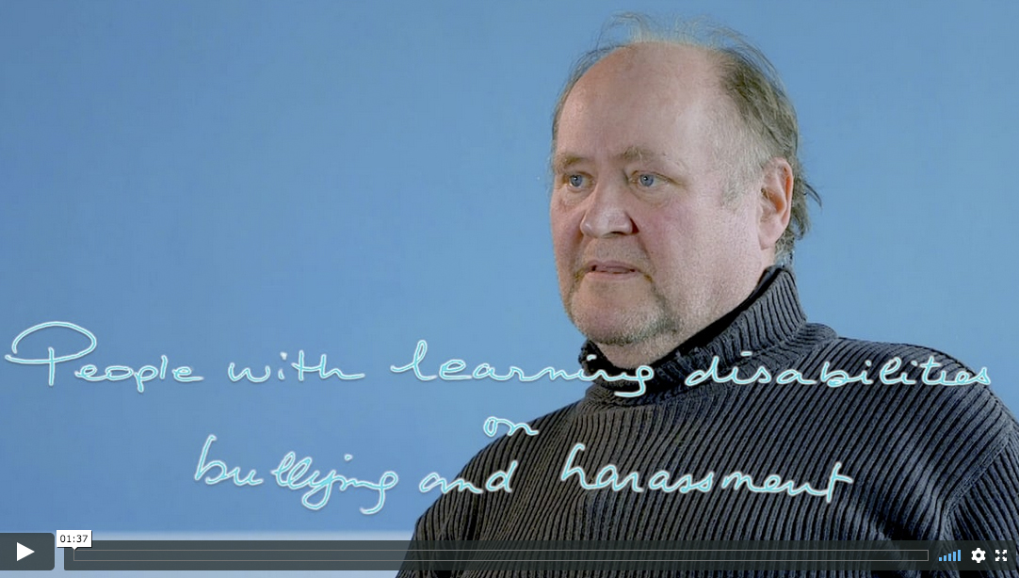
Group work
Section 1
Slide 17
Intellectual disability 1: Bullying

Slide 18
Triggers for mental health difficulties
Section 1
Slide 18
Our life experiences (neglect and abuse).
Mental health difficulties within the family.
Physical factors including our genes and some physical illnesses.
Everyday stresses such as:
  coping without support
  bullying
  having our choices limited.

Slide 19
Signs and symptoms of mental health difficulties observed by others
Section 1
Slide 19
Objective changes in:
Subjective changes in:
physical appearance
health and hygiene
sleep/weight
level of activity
relationships
verbal/non-verbal communication
repertoire of adaptive behaviour.
motivation
mood
energy/appetite
perception of others, objects and environments
self perception, insight and self-esteem.

Slide 20
Signs as experienced by the person with mental health difficulties
Section 1
Slide 20
Feeling lethargic, lacking energy and motivation.
Negative thoughts and feelings.
Problems concentrating.
Eating too much or too little.
Sleeping too much or too little.
Emotional or tense and experiencing mood swings.
Feeling more worried than usual.
Physical symptoms such as racing pulse, feeling sick, feeling that there is something physically wrong.

Slide 21
Other possible signs of mental health difficulties
Section 1
Slide 21
Onset of or increase in behaviour which is described as challenging.
Changes in attention, thinking and learning.
Difficulties with memory and adaptation.
Attitudes to health and support needs.

Slide 22
What is an intellectual disability?
Section 1
Slide 22
Intellectual disability is not a mental illness, but is a lifelong condition that affects learning and the retention of new information.
Intellectual disability is often a hidden condition that may not be obvious to others.
Many people with a intellectual disability are able to live independently and never come to the attention of services.

Slide 23
How does intellectual disability affect day-to-day lives?
Section 1
Slide 23
Communication.
Daily living skills.
Challenging behaviour.
Sensory impairment.

Slide 24
Presentation of mental health difficulties in people with intellectual disabilities
Section 1
Slide 24
May be atypical e.g. agitation in depression, self injurious behaviour.
Can be dependent on staff identifying a problem e.g. social withdrawal.
Problems can be masked e.g. changes in personal care and appearance may not be noticeable due to regular support from others.

Slide 25
Risk factors for mental health difficulties
Section 1
Slide 25
Biological factors such as:
  genetics
  body and brain chemistry
  hormones.
Psychological factors such as:
  thinking patterns – how we deal with problems and negative thoughts and what we think about ourselves
  chronic or acute stress.
Social factors such as:
  being out of work
  being isolated from others
  life events such as break ups or the end of relationships e.g. a support worker leaving
  use of alcohol and drugs, both legal and illegal.

Slide 26
Intellectual disability and mental health
Section 1
Slide 26
People with an intellectual disability are more likely to experience mental ill-health than the wider population*.
When assessing and treating a person with an intellectual disability for mental health difficulties, adaptations to treatment may have to be made.
The impact of having an intellectual disability can make it more difficult for someone to help themselves.
The role of the support worker is vital to achieving maximum wellbeing.
*Cooper S.A., Smiley E., Morrison J., Williamson A & Alan L. ( 2007) Mental Ill-health in adults with intellectual disabilities: prevalence and associate factors.
British Journal of Psychiatry 190 27-35
Smiley E. (2005) Epidemiology of mental health problems in adults with learning disability: an update. Advances in Psychiatric Treatment 11, 3, 214-222

Slide 27
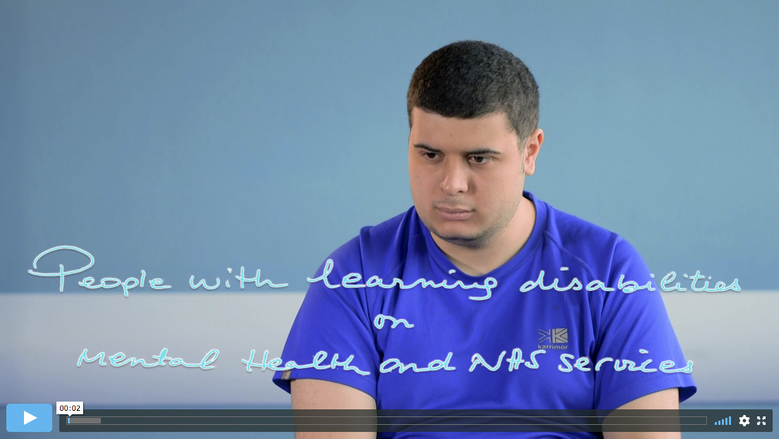
Video
Section 1
Slide 27
Intellectual disability 2: About the NHS

Slide 28
Case study – Joe
Section 1
Slide 28
Joe has an intellectual disability and autism. He recently started a new activity programme, which he was happy about. However, Joe soon started having problems and would become agitated waiting to go to sessions. Joe’s support team decided to look at what might be responsible for this change in behaviour. Before episodes where he became upset, Joe would often ask the time. His difficulties telling the time and waiting for activities appeared to be causing the problem. Staff recognised that the clock was distracting as he couldn’t tell when the activity would start, which led him to ask questions and become more agitated. The issue seemed to be the minute hand, which Joe would become fixated with, waiting for the activity to start and not understanding the length of time left to wait.

Slide 29
How Joe was supported
Section 1
Slide 29
To try and help, the minute hand was removed which meant Joe did not have to worry about the length of time to wait.
When the hour hand changed he knew that the next timetabled activity would start.

Slide 30
Section 2: What is mental illness and common mental health diagnoses?
Section 2
Slide 30
Common mental health diagnoses
  Mood disorder and depression.
  Psychosis.
  Bipolar disorder.
  Schizophrenia and psychosis.
  Personality disorder.
  Dementia.

Slide 31
What is mental illness? (II)
Section 2
Slide 31
Mental illness will significantly affect how a person thinks, behaves and interacts with others.
Like physical illness it can be diagnosed only when certain key signs and symptoms are present.
For some with severe forms of mental illness, a spell in hospital may be required either as a voluntary patient or detained under the Mental Health Act.
Mental illnesses are often grouped together by symptoms and include mood, psychotic and personality disorders.

Slide 32
Common signs and symptoms of mental illness
Section 2
Slide 32
Feeling lethargic, lacking energy and motivation.
Negative thoughts and feelings of helplessness.
Problems concentrating.
Eating too much or too little.
Sleeping too much or too little.
Emotional or tense and experiencing mood swings.
Constantly worried, nervous or scared, which may cause conflict in everyday situations.
Physical symptoms such as racing pulse, feeling sick, feeling that there is something physically wrong.
Unpleasant thoughts that a person can’t stop thinking about and cause them stress (ruminations).
Hearing voices that are not there (hallucinations).
Having false beliefs about everyday situations that are not true (delusions).
Thinking of harming or hurting yourself.
Irrational fear and panic.

Slide 33
Mood disorders
Section 2
Slide 33
Although symptoms can vary widely between individuals, low mood is common to everyone suffering depression. Symptoms can include:
  lack of energy
  lack of motivation
  feeling hopeless
  feelings of unworthiness
  difficulties making decisions
  poor memory
  poor concentration
  low self-esteem.

Slide 34
Case study: depression – Mr A
Section 2
Slide 34
Mr A is 25 years old and lives in a residential home. His staff team describe him as being active and outgoing and always willing to take part in activities around the house and in the community. Mr A has some verbal communication and makes his needs known using some words, gestures and vocalisations. Staff began to have concerns about Mr A’s mental health and took him to see his GP. They explained that Mr A had stopped initiating conversations and would only reply to them using one or two words; they said that he appeared sad and troubled. Over the last six months, Mr A had started to stay in his bedroom and only come down for meals, however he recently stopped even doing that. The staff are worried about Mr A because he is losing weight and staying in his bedroom all the time. The GP asks the staff questions about Mr A’s social circumstances; he finds out that before these changes Mr A’s key worker left the home for a new job and that shortly after this the staff team started to notice small changes in Mr A’s usual routines and behaviour, and that this gradually escalated over the weeks culminating in Mr A’s initial appointment.

Slide 35
Who did what to support Mr A
Section 2
Slide 35
Mr A’s GP is concerned about his weight loss and recommends a blood test which the staff manage to support him to have and which comes back normal. The GP suspects that Mr A might be experiencing a grief reaction to the loss of his key worker. This would usually be considered a normal human emotion, but because Mr A’s behaviours are becoming more severe; he is losing weight, refusing meals and not sleeping, he diagnoses a reactive depression and recommends that Mr A access adapted grief counselling and prescribes anti-depressant medication.

Slide 36
Psychosis
Section 2
Slide 36
A general rule is that the person will lose touch with reality.
Around 1% of people are thought to suffer from psychotic disorders such as schizophrenia (NIMH, 2016).
For people with an intellectual disability this is thought to be as high as 3%. These disorders are often referred to as ‘severe mental illnesses’.

Slide 37
Psychotic disorders – bipolar disorder
Section 2
Slide 37
Bipolar disorder is a psychotic disorder. Some people with depression may also experience periods of elation or hypomania. This is commonly known as bipolar disorder. This is characterised by mood swings, which can range from severe lows (depression) to severe highs (mania). When someone is manic or hypomanic they may present with:
  feelings of grandiosity
  raised self-esteem and over confidence
  talking rapidly (pressure of speech)
  racing thoughts (pressure of thought)
  delusions
  hallucinations
  acting irrationally e.g. sexual disinhibition, over spending.

Slide 38
Schizophrenia and psychosis
Section 2
Slide 38
Psychosis:
  Affects and distorts the person’s sense of reality across their senses – in the form of hallucinations and delusions
  Positive symptoms such as hallucinations and delusions are usually present in the acute phase
  Whereas chronic schizophrenia can be characterised by negative symptoms such as residual or fleeting symptoms, negative thoughts, lack of motivation and interest in their surroundings.
Other symptoms include:
  difficulties in determining what is real or not
  muddled thinking and speech
  difficulty in relating to others
  poor motivation
  self-neglect
  poor self-care.

Slide 39
Schizophrenia, psychosis and intellectual disability
Section 2
Slide 39
People with an intellectual disability can experience psychotic illness and some may experience different signs and symptoms to the wider population.
The more severe the intellectual disability the more likely that signs of
a psychotic disorder may present ‘behaviourally’, for example with aggression and/or self injurious and self-harming behaviours.
The content of delusions and hallucinations can be less elaborate than in the wider population and could be mistaken for infantile-like fantasies.

Slide 40
Case study: Schizophrenia – Olayemi
Section 2
Slide 40
Olayemi is a 19-year-old man with an intellectual disability. Over the past few weeks his family and friends have noticed increasingly bizarre behaviour at college, such as whispering to himself and becoming easily agitated. Over the last week he has refused to attend sessions in the computer labs as he thinks that the people who work there are imposters who don’t want him there. The college welfare department have called Olayemi’s parents with their concerns and have recommended he see his GP. In the last few days he has gone to the door of the library and warned other students not to go in as something might happen to them. His parents have tried to get him to go with them to a psychiatrist for an assessment but he refuses.

Slide 41
What happened next and how
Olayemi was supported
Section 2
Slide 41
Concerned for him and his behaviour, the college have suspended Olayemi. He eventually sees his GP who sends him to see a psychiatrist who believes Olayemi has an early stage of schizophrenia. After starting on medication Olayemi improves. The psychiatrist works with college welfare and makes a plan with Olayemi for what to do if the strange thoughts start to reoccur or become too distressing. This is helpful for Olayemi who has difficulty recognising or talking about ‘things’ that happen to him.

Slide 42
Personality disorders
Section 2
Slide 42
It is estimated that around 1 in 20 people in the general population have a personality disorder. The term is often used negatively to describe people whose actions challenge our patience.*
Personality disorders are characterised by:
maladaptive and anti-social patterns of behaviour
had to have occurred from childhood and are a natural response for the person to situations of adversity.
The different types of personality disorder include:
  paranoid
  schizoid
  dissocial
  emotionally unstable
  (impulsive and borderline types)
  histrionic
  anakastic
  dependent.
  *https://www.rcpsych.ac.uk/mental-health/problems-disorders/personality-disorder

Slide 43
Common types of personality disorder
Section 2
Slide 43
Paranoid personality disorder
Dissocial personality disorder
Borderline personality disorder (BPD)

Slide 44
Paranoid personality disorder
Section 2
Slide 44
Paranoid personality disorder is characterised by:
being suspicious of others, thinking they are out to do the person harm or just want to use them and take advantage
difficult to develop relationships given difficulties with trust
reading threats and danger into everyday situations which others don’t see.

Slide 45
Dissocial personality disorder
Section 2
Slide 45
People with dissocial personality disorder are likely
to act impulsively with no thought of the consequences to themselves or others. They are also likely to get
into trouble with the law and more likely to behave dangerously and/or illegally than others. Often they will put their needs before those of others and often have no sense of guilt for their actions.

Slide 46
Borderline personality disorder (BPD)
Section 2
Slide 46
People in this group can be described as changeable – they may appear temperamental, go through mood changes and suffer from brief and transient psychotic symptoms such as hallucinations.
People can be impulsive, which affects relationships with those around them, who may feel they are being tested due to the erratic nature of the person’s behaviour. This might include self-harm or testing others.

Slide 47
Case study: personality disorder – Rani
Section 2
Slide 47
Rani is a 35-year-old woman who was admitted to A&E after cutting her wrists and taking an overdose of painkillers. For most of her adult life she has felt alone and not had any proper or meaningful relationships. Although she has liked people, often her behaviour has caused these friendships to break up. Rani believes those around her do not understand her and she has been critical of, and angry and sullen towards, others who were trying to help her. In the last week, following a review meeting and before going to hospital, she started shouting at people and engaging in impulsive behaviours like running away from home. Staff at the house had become concerned about her as she had also become increasingly emotional and subject to rapid mood changes which were difficult to predict.

Slide 48
How Rani was supported
Section 2
Slide 48
At A&E Rani is seen by a psychiatrist who prescribed her an antidepressant for her low mood and referred her to a psychologist to work on some of her issues. Since going to see the psychologist Rani still feels overwhelmed at times and gets angry. However, this is not as often nor as bad as before. Rani puts this down to new strategies and coping skills she has learned to help her be in control and manage her symptoms.

Slide 49
Dementia
Section 2
Slide 49
Dementia describes a set of symptoms involving different neurological disorders. It is a progressive disorder which means that the severity of
the symptoms increases with time. People with dementia often experience difficulties with their:
  memory
  language and communication
  behaviour and mood changes.
People with intellectual disabilities particularly those with Down’s Syndrome are at an increased risk of developing dementia and they are more likely to get it at a younger age with a faster progression than others.

Slide 50
Case study: dementia – Annie
Section 2
Slide 50
Annie is 64 years old and lives in supported housing. She works at a local charity shop for two afternoons a week. Over the past six months, staff at the charity shop and Annie’s support workers have noticed that she doesn’t seem to enjoy working anymore and that she will try to avoid going to work. A community nurse meets Annie and talks to her about this. Annie becomes upset and says that she doesn’t want to go to work anymore as she is ‘embarrassed’. When asked more about this she explains that she often forgets how to use the till and has made mistakes with money, and that sometimes she cannot find the toilet even though that was never a problem before. Annie tells the nurse that she is worried about herself and that she does not understand why she can’t do the things that she used to. Annie’s support workers have noticed that she has had a number of trips and falls over the past eight weeks and Annie’s colleagues noted that she has started to struggle to join in with conversations and gets muddled up, whereas previously she would happily sit and chat to everyone.

Slide 51
Section 3 – Mental health assessment for people with an intellectual disability
Section 3
Slide 51
Principles of assessments.
Information for assessments.
People that may be involved in the assessment.
Difficulties with assessments.
How to support individuals in assessments.
Reasonable adjustments.

Slide 52
Principles of assessment
Section 3
Slide 52
Mild intellectual disability and reasonable verbal communication skills: assessment is similar to the general population.
Severe intellectual disability and limited communication skills: rely on changes in behaviour and the observations of others.
We must always consider possible underlying physical illness – may contribute to changes in behaviour and functioning.

Slide 53
Assessment
Section 3
Slide 53
It is important that a thorough assessment is completed if you have concerns about a person with an intellectual disability.
Clinicians will often rely on individual accounts and reporting of symptoms which some people with an intellectual disability will find more difficult to do.
Support is vital to ensure that communication is appropriate to the individual and that they have been given sufficient time to understand and reply to questions.
Additionally, you may be required to complete observations of particular behaviours over a period of time to notice any changes and to understand the function of a particular behaviour.
A physical health check should also be completed to rule out any physical causes for the changes.

Slide 54
Case study: Mohammed
Section 3
Slide 54
Mohammed has an intellectual disability. You accompany Mohammed to an appointment with the Mental Health Learning Disability Team. The clinician asks Mohammed ‘Can you tell me why you have been asked to come to your appointment today?’. Mohammed indicates that he does not understand the question and turns to his support worker. As a support worker, what could you do to support Mohammed to understand what is being asked?

Slide 55
Information needed for assessment (I)
Section 3
Slide 55
Information about the person’s history and current state/situation should be gathered from a number of sources – service users, family, staff, clinicians, case notes.
The assessment should be holistic and should be based
on the bio-psycho-social model.
Assessment should consider factors contributing to the development of the illness.

Slide 56
Information needed for assessment (II)
Section 3
Slide 56
Mental health symptoms and experiences.
Feelings, thoughts and actions.
Physical health and wellbeing.
Housing and financial circumstances.
Employment and training needs.
Family/social relationships.
Family history.
Culture and ethnic background.
Gender and sexuality.
Drug or alcohol use.
Past experiences, especially of similar problems.
Risk issues.
Dependants.
Strengths/skills and what helps you best.
Hopes and aspirations for the future.

Slide 57
People that may be involved in assessment and treatment
Section 3
Slide 57
  The person themselves.
  Family and carers.
  Psychiatrists.
  Nurses.
  Social workers.
  Psychologists and behaviour support.
  Occupational therapists (OTs).
  Speech and language therapists (SLTs).

Slide 58
Person with an intellectual disability
Section 3
Slide 58
Involving the person is the most important part of any assessment
or treatment.
The person must be encouraged and supported to talk to relevant professionals about what they are experiencing.
The person must be supported to understand the treatment and other options that are available to them and supported to make choices.
They should be provided with a variety of communication resources to enable them to actively participate in these conversations and planning, implementing and evaluating/reviewing treatment and support.

Slide 59
Family and carers
Section 3
Slide 59
Family and carers are the people who will know information about the person and how they communicate.
Family that are closely involved with the person must always be invited to assessment, treatment and reviews.
Family can also provide information on past relevant issues relating to the support needs of the person.

Slide 60
Advocates
Section 3
Slide 60
The role of an advocate is to offer independent support to those who feel they are not being heard and to ensure they are taken seriously and that their rights are respected
They can also assist people to access and understand appropriate information and services
Advocates can also support the person and others in resolving conflicts while maintaining the rights and autonomy of the person

Slide 61
Psychiatrists
Section 3
Slide 61
A psychiatrist has completed full medical training before they specialise in psychiatry
They work as part of a multi-disciplinary team in supporting people with mental health problems
Psychiatrists will assess an individual’s mental state, make a diagnosis, prescribe medication and provide follow up appointments and medication reviews. They will likely liaise with GPs and other doctors who may be involved in the person’s care

Slide 62
Nurses
Section 3
Slide 62
Nurse work as part of the multi-professional team to assess mental and physical health and wellbeing
Learning disability and mental health nurses assess, monitor and review behaviours and mental state and offer interventions around medication management, individualised care plans and health promotion. They also co-ordinate care around the person
Community mental health nurses play a major role in supporting people to remain at home while on treatment instead of in hospital

Slide 63
Social workers
Section 3
Slide 63
Social workers help assess the individual’s needs and find suitable accommodation, care and support and funding for these. They also play a leading role in safeguarding people.
A social worker will also assess the person’s social situation and how this is impacting or contributing to the mental health problem.
It may involve looking at where the person lives, daytime activities and opportunities, education, finances and vulnerability issues.

Slide 64
Psychologists and behaviour support services
Section 3
Slide 64
Psychologists and behaviour support may assess and provide talking and behavioural therapies.
To try and understand the function and causes of challenging behaviour and to help service users develop more appropriate behaviours.
To help service users experiencing distress using talking therapies.
To work with the service user and carers to help manage their feelings.

Slide 65
Occupational therapists
Section 3
Slide 65
Occupational therapists may assess daily living skills and functioning and make recommendations for support and skill development
They aim to help people improve or maintain skills for day-to-day activities and wellbeing
They work in partnership with their people and other professionals to identify important and valued activities that are difficult to do because of their mental health problem and/or intellectual disability.

Slide 66
Speech and language therapists
Section 3
Slide 66
Speech and language therapists (SLTs) can assess, treat and support adults who have difficulties with communication, or with eating, drinking and swallowing.
They can advise on alternative and augmentative communication techniques to enhance quality of life and contribute to mental health assessments.

Slide 67
Difficulties with assessment
Section 3
Slide 67
The individual
Parent/carers/staff
Communication.
Acquiescence.
Reduced attention span.
Observations of behaviour may be aberrant and may be normal in the context of the person’s intellectual disability.
Diagnostic overshadowing.
Behavioural overshadowing.
Lack of experience and skills.
Staff turnover.
Incomplete knowledge of the individual.
Often can only report on signs and not symptoms.

Slide 68
Ways to support someone in assessment, care and treatment
Section 3
Slide 68
When supporting an individual to access mental health services it is important to provide emotional, psychological and practical support.
  Ensure that you and the person you are supporting are prepared and informed about the appointment.
  Ensure that the health staff that you are meeting are aware of reasonable adjustments that should be made such as longer appointment time, Easy Read information and any environmental adjustments.

Slide 69
Reasonable adjustments
Section 3
Slide 69
Intellectual disability 3:
Mental health services
Brainstorm what ‘reasonable adjustments’ means and think of related examples from practice.
Watch the second part of the video and discuss the reasonable adjustments that Kevin and his colleagues would like to experience.

Slide 70
Section 4: Mental health interventions and treatment for people with intellectual disabilities
Section 4
Slide 70
Principles of interventions.
Psychological interventions/talking therapies.
Medication.
Electroconvulsive therapy.

Slide 71
Principles of intervention
Section 4
Slide 71
Should be firmly based on the outcome of the assessment.
Should aim at reducing:
  signs and symptoms
  distress to the individual
  likelihood of relapse.
Should aim at increasing social inclusion.
Should include a range of interventions based on the
bio-psycho-social model.
Should be multi-professional.
Should aim to reduce vulnerability factors and increase protective factors.
Should be regularly reviewed and evaluated.

Slide 72
Psychological interventions/ talking therapies
Section 4
Slide 72
Psychological therapies are a treatment where an individual speaks to a trained therapist about their experiences.
Depending on the interventions used, these treatments may offer time to reflect, let the person be listened to, help the person understand their situation or help them understand how their thoughts, feelings and behaviour affect each other.

Slide 73
Types of talking therapies/interventions
Section 4
Slide 73
Positive behaviour support (PBS).
Cognitive behavioural therapy (CBT).
Mindfulness.
Guided self-help (GSH).

Slide 74
Psychological interventions formats
Section 4
Slide 74
Individual (direct).
Group – for people with intellectual disabilities presenting with similar needs.
Systemic – with carers/family/staff (indirect).
Behavioural support.

Slide 75
Medication (I)
Section 4
Slide 75
When being prescribed medication or supporting someone experiencing mental ill health, there is certain information the doctor will need and which you should be familiar with e.g:
knowing what medications (including items such as herbal or vitamin supplements) the person is currently taking or has been taking recently
any sensitivities or allergies they may have
other issues, such as difficulty swallowing tablets or fear
of needles for those taking long-acting injections.

Slide 76
Medication (II)
Section 4
Slide 76
When someone is diagnosed with a mental illness, they may be prescribed medications to treat the illness and/or relieve symptoms.
There are different groups of medication that target different types of mental illness.
Other medications can also be prescribed to relieve challenging symptoms such as anger, aggression or poor sleep.
If medications are prescribed you should make sure that you have information about:
  the name of the medication and what it is prescribed for.
  how long the medication should be taken for and when it will be reviewed.
  how you will know if it is working.
  any side effects or potential drug interactions and what to do about them.
  how to take the medication.

Slide 77
Types of medication
Section 4
Slide 77
Antidepressants, most commonly used in the treatment of depression but may also relieve anxiety or be useful in eating disorders in some cases.
Antipsychotics, most commonly used in psychotic illnesses such as schizophrenia, mania or in severe agitation.
Mood stabilisers, mostly used in bipolar disorders but some drugs in this group will also be used to treat epilepsy.
Anxiolytics, which have commonly been over-prescribed and can be addictive. They are usually used short term for severe anxiety or insomnia.
Most medications are given in tablet form although for some people with psychosis, long-acting injections might be used.

Slide 78
Overmedicating (I)
Section 4
Slide 78
There is a lot of evidence that people with intellectual disabilities are more likely to be given psychotropic medication.
Often these medications are given to manage challenging behaviour in patients without a diagnosed mental illness.
There is a project in England called ‘STOMP’ – Stopping Over Medication Of People with learning disabilities, autism or both.

Slide 79
Overmedicating (II)
Section 4
Slide 79
Approx. 30,000 to 35,000 adults with intellectual disabilities are
taking psychotropic medicines when they do not have a mental illness.
Many of these medications have side effects.
STOMP project is aimed at GPs, support staff and intellectual
disability teams.
It aims to ensure that people only receive these medications for
mental illness and that they are monitored.
You can read about this at:
https://www.england.nhs.uk/learning-disabilities/improving-health/stomp/

Slide 80
Electroconvulsive therapy (ECT)
Section 4
Slide 80
ECT is used when other treatment methods have failed for people with severe depression and is used where there is a risk to life or further serious deterioration of a person’s condition
In some cases it is also used to treat mania
For many, ECT has an almost immediate effect
Support is necessary both during and between sessions
Some people who have ECT complain about memory loss or, feel their memory is not as good as it used to be

Slide 81
Section 5: Mental health promotion and the views of people with an intellectual disability
Section 5
Slide 81
Mental health promotion.
Mental health promotion groups for people with an intellectual disability.
Two examples of groups.
Role of support workers.
What staff should know and be good at in mental health promotion.
Bill of Rights.

Slide 82
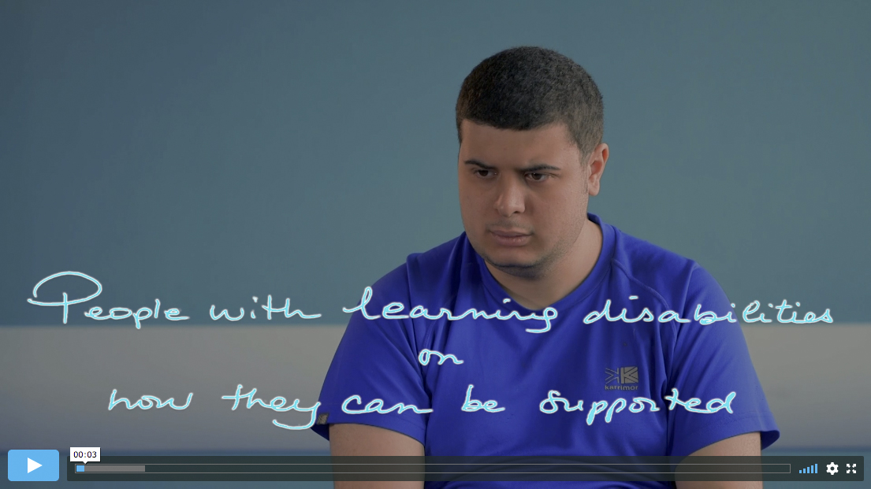
Mental health promotion and the views of people with an intellectual disability
Section 5
Slide 82
Intellectual disability 3:
How they can
be supported

Slide 83
Mental health promotion (I)
Section 5
Slide 83
Mental health promotion involves any action, thoughts, intentions etc to enhance the mental wellbeing of individuals and their families.
Mental health promotion initiatives can be targeted at organisations or communities in the form of public health campaigns.

Slide 84
Mental health promotion (II)
Section 5
Slide 84
Mental health promotion can be complex with a number of components, and may include:
  managing change
  modifying the environment
  making contact with other people and developing relationships
  recognising, understanding and communicating thoughts and feelings
  managing negative and positive experiences and feelings
  (stress and adversity)
  believing in their ability or capacities e.g. experiencing achievements
  developing feelings of self-worth.

Slide 85
Starting a group
Section 5
Slide 85
Mental health promotion groups such as Mindapples and The Tuesday Group were set up to help support people with an intellectual disability to develop, practise and learn new skills to promote positive mental health.
Both groups were formed following consultation with local service user organisations on what support people with an intellectual disability wanted for their mental health. A common theme was a need for support groups and information about mental health problems and how people can stay mentally well.

Slide 86
Format of groups
Section 5
Slide 86
Groups can operate on an ongoing open basis or be time-limited.
What topics do you feel it is important to include to promote positive mental health?

Slide 87
How to self-care
Section 5
Slide 87
Learn ways to relax and ways to help you sleep.
Know what can make you depressed or anxious.
Have information that is easy to understand about mental health and services.
Speak up for yourself.
Recognise your own emotions and feelings and identify situations that might
be stressful.
Help to cope with stressful events more effectively.
Raise awareness of non-psychotic illness, especially depression and anxiety.
Provide information regarding the range of services available in their local area, not only clinical services, but also leisure, advocacy and support services.

Slide 88
Case study 1 – The Tuesday Group
Section 5
Slide 88
The first group comprised a ten-week course of two-hourly sessions and was aimed at reducing or preventing the likelihood of people developing depression (non-psychotic) and anxiety disorders. The sessions covered:
  General introduction, getting to know each other, establishing ground rules.
  Understanding and recognising your emotions, especially those associated with depression/anxiety, and the situations in which they might occur.
  Depression and how it can affect you.
  Personal factors and preventive strategies.
  Anxiety and how it can affect you.
  Personal factors and preventive strategies.
  What happens if someone becomes mentally ill?
  Developing individual, positive mental health plans.
  Continuation of session eight.
  Review of the course.

Slide 89
Strategies for supporting people with mental illness – The Tuesday Group
Section 5
Slide 89
What’s the best way for me to treat someone else with mental health problems?
  When someone is distressed, unwell
  or acting strange, what should people
  do to help them?
  What are the things to avoid doing or
  saying that may make the situation worse?
How can people help me?
  Involving people in my care and recovery.
  Listening to what I have to say and find
  out about me.
  Treating me equally, involving me,
  and remembering that I am a person.
  What if I get into trouble when I am
  not well?
Seeing health professionals
  Using questionnaires to find out how
  I am feeling.
  Giving my nurse or doctor information
  about me.
  What to do if I don’t understand or
  forget what people are talking about?
  Why do they want to see me again?

Slide 90
Case study 2 – Mindapples (I)
Section 5
Slide 90
Mindapples started as a one-day workshop for a group of people with an intellectual disability on how to understand your mind and ways to stay physically and mentally well.
During the evaluation participants expressed an interest
in having a weekly support group to continue on the Mindapples themes.
As with the first workshop the weekly groups are also
co-facilitated by an expert-by-experience.

Slide 91
Case study 2 – Mindapples (lI)
Section 5
Slide 91
The group sometimes invites other professionals to come and give information and advice on related subjects.
The group does a combination of learning together about relevant issues and doing activities such as music and movement, relaxation, and parties to celebrate occasions.
The group plans to get involved in national celebrations such as Learning Disability Awareness week and also participate in giving feedback to other relevant initiatives such as government policy and legislation consultations.

Slide 92
Role of support workers
Section 5
Slide 92
Accompanying clients to/from sessions.
Providing support after sessions e.g. distraction, quiet time, company.
Monitoring charts e.g. ‘ABC’.
Helping service users with homework.
Helping service users remember to bring work to therapy.

Slide 93
What staff should know (I)
Section 5
Slide 93
Valuing People.
Rights.
Choices.
Independence.
Being included.
What is good for mental health?

Slide 94
What staff should know (Il)
Section 5
Slide 94
How to tell if someone has a mental health problem.
That you ask questions to the person and not the parent or staff.
They should understand that the person has their own thoughts and feelings.
About medication and talking therapies.
That you have to ask the person to give consent for treatment.

Slide 95
What staff should be good at
Section 5
Slide 95
How to help people be healthy.
Understanding people’s needs.
Teaching people ways to be calm.
What tablets people take and why.
To be aware of side effects of medication.
How to give support with problems like depression.
What other services can help people with their mental health problem.

Slide 96
Bill of Rights (Tuesday Group)
Section 5
Slide 96
We have the right to be treated with respect.
We have the same rights as any other person.
We should have the same opportunities as any other person.
We have the right to make our own decisions.
We have the right to use the same mental health services as other people.
We have the right to an advocate if we want one.
We have the right to be included in all discussions about our mental health.
We have the right to a wide range of treatments, not just medication.
We have the right to see what is written about us.

Slide 97
Finally
Section 5
Slide 97
Talk about…
At least one thing you have learnt today.
At least one thing that you will change or implement in your practice as a result of today’s learning.

